Slide 1

Coffee Shop Management
CCD

Slide 2

Introduction
Full Stack Application – Coffee Shop Management
A management system is an application that
is designed to manage all the functions of a Coffee Shop
It helps owner to maintain the database of new
costumers and items.

Slide 3

Technologies Used To Developed
Full Stack Application
HTML
CSS
Bootstrap
Angular
Spring-Boot
JPA Hibernate
MySQL
Core Java

Slide 4
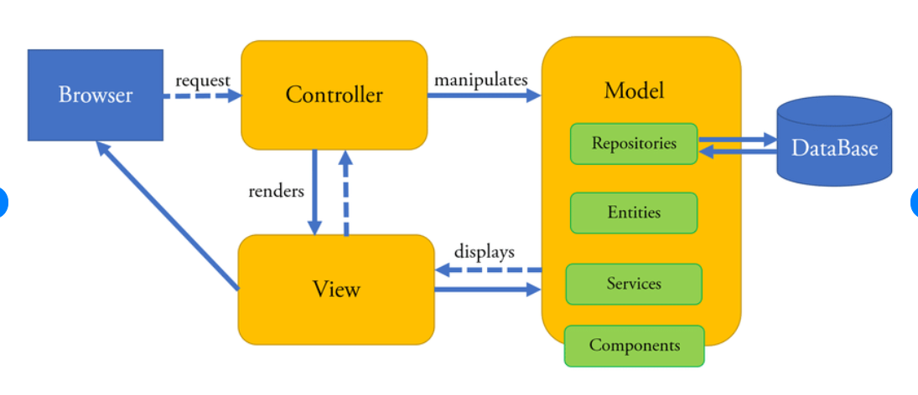
Architecture of Angular, Spring-boot & Database

Slide 5
Crud Operation in Project
FULL-STACK
Add-Product
Update-Product
Delete-Product
View-Product

Slide 6
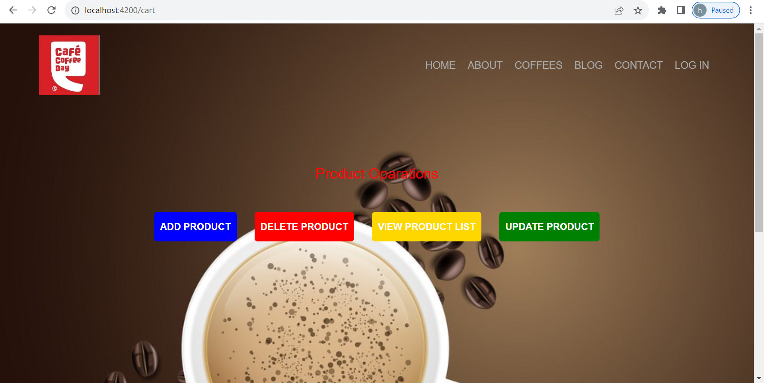
Crud Operation Page

Slide 7
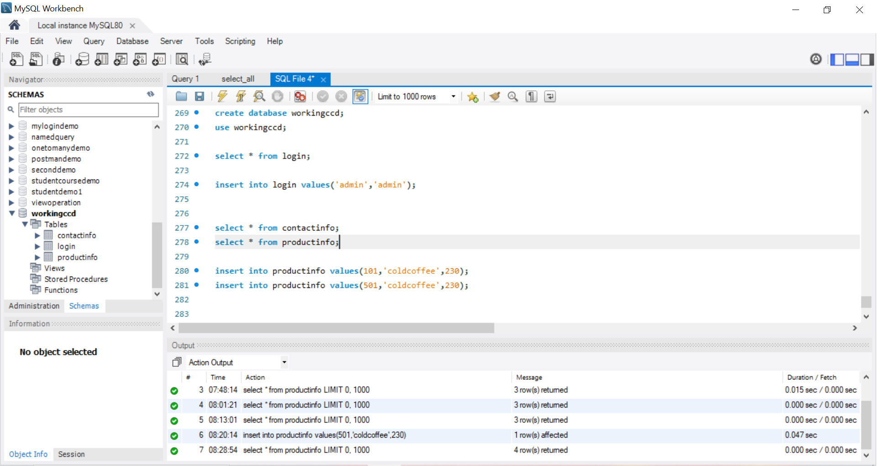
Structure Query Language for Database in MySQL with Workbench Editor

Slide 8
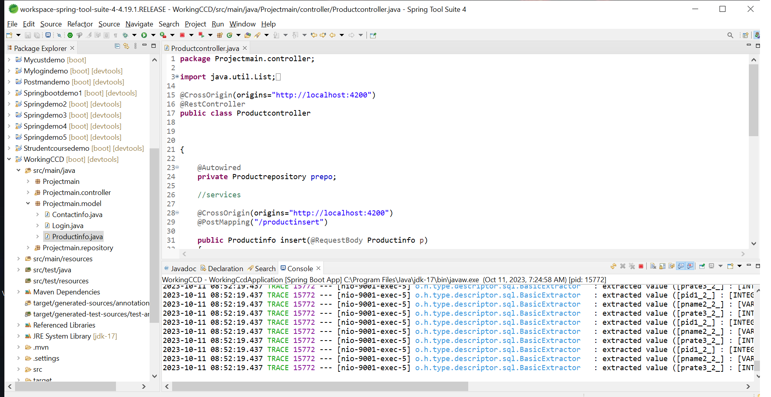
Java Controller Using Spring-Boot with STS Editor

Slide 9
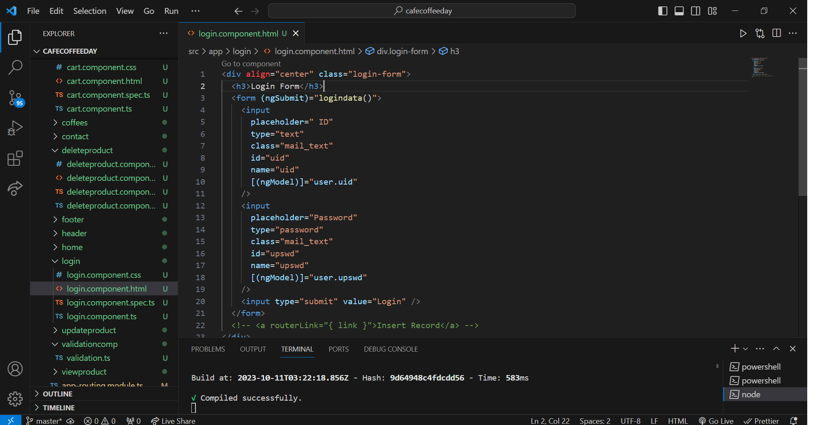
Front-End Code Using HTML,CSS & Angular in VS Code Editor

Slide 10
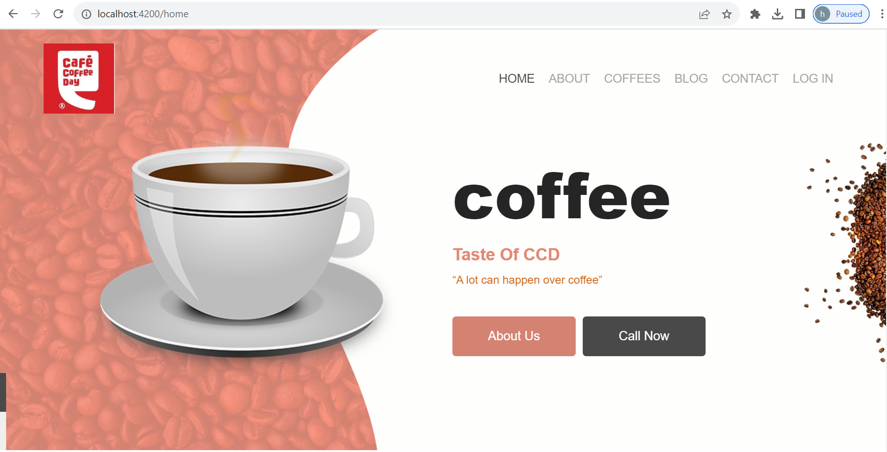
Home Page

Slide 11
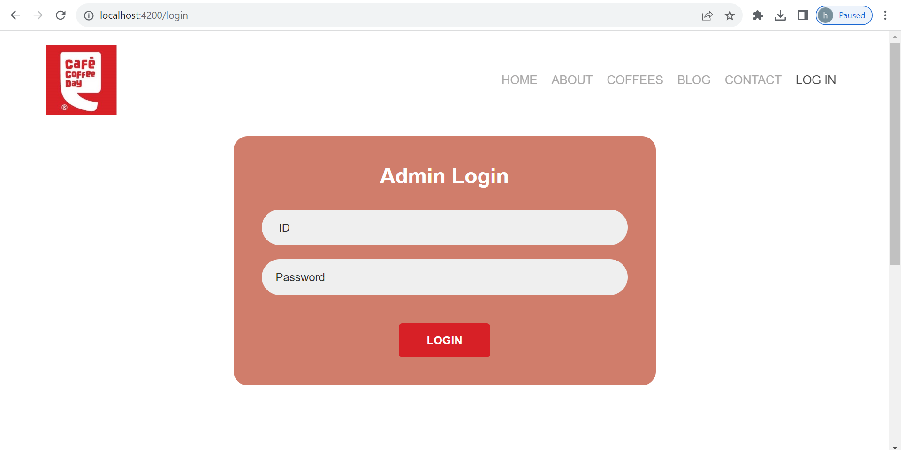
Admin Login Page

Slide 12

Future Scope
In this full stack project we can implement more function in future
We can add more function to make it complete based on backend
We can add e-commerce functionality
We can add payment method, User authorization, add security features.

Slide 13
GitHub Link :-https://github.com/cleancity1234/FinalProject.git

Slide 14


